Slide 1
Optical Character Recognition
Suryansh Rana Jain
Ria Qi
Nicolas Rios

Slide 2

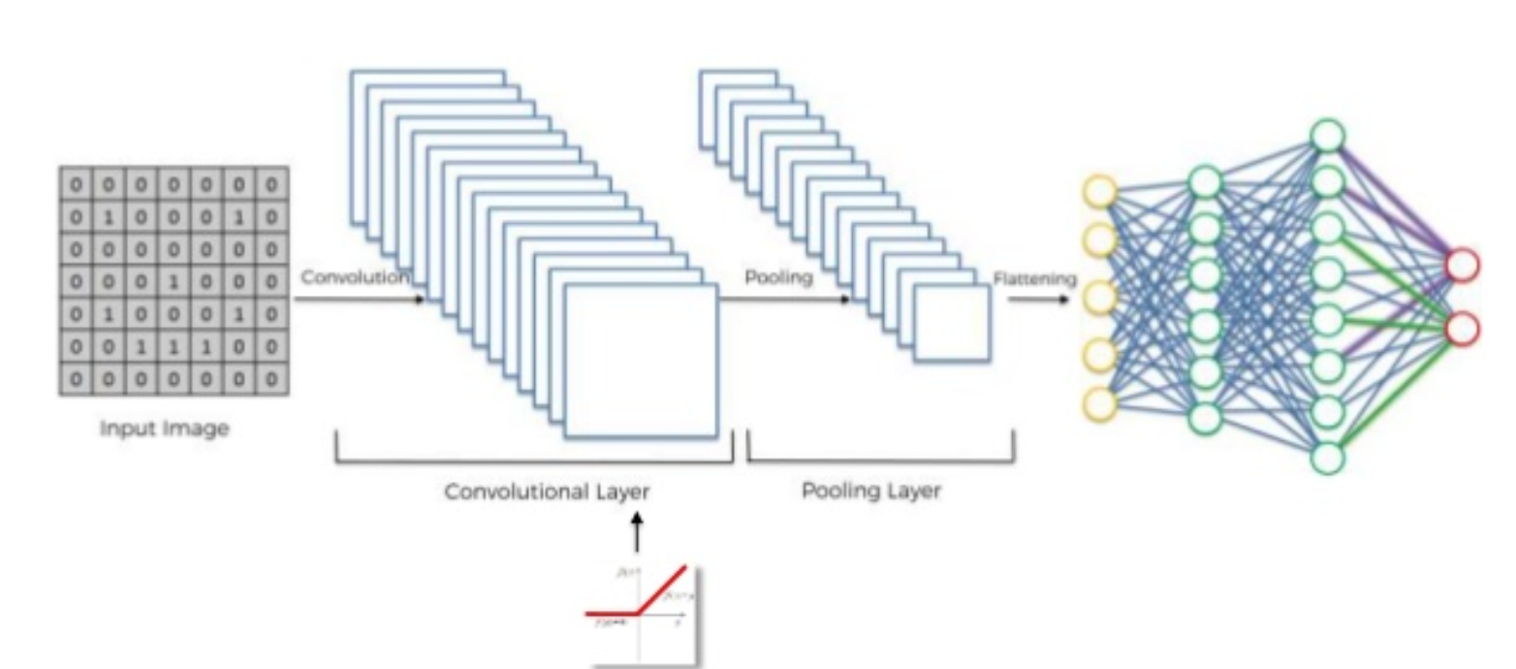
How we built it
Image Processing
Segmentation
CNN
Languages Used:
Python
Bash

Slide 3
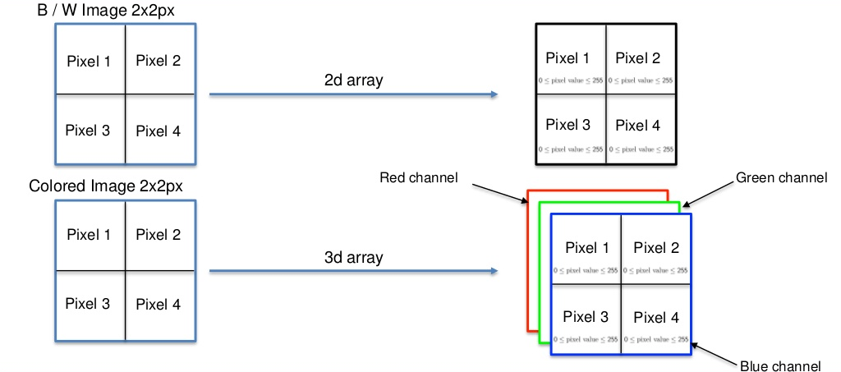
Notes:
In real life we see the pixels as black white or colored but in the digital world these pixel have a value between 0 and 255, with 0 being completely black and 255 being completely white. The values between are greyscale in a 2D array
For coloured pixels we have red blue and green channels with each pixel having values between 0 and 255. These are 3D array

Slide 4


Image pre-processing - Grayscale
L = R * 299/1000 + G * 587/1000 + B * 114/1000
Notes:
Turning picture into a numpy array
Reading each pixel to obtain its grey intensity in the range of 0 - 255

Slide 5
Image pre-processing - Noise Cancelling
Noise cancelling algorithm
Divided the graphs into blocks
calculate the mean and STD of the grayscale intensity of blocks
if the STD < 15
if mean < 130
all background
if mean >= 130
all foreground
Otherwise:
threshold = 0.875 * mean

Slide 6
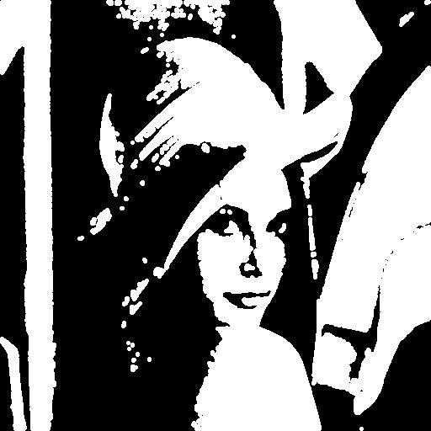
Image pre-processing - Binarization

Slide 7
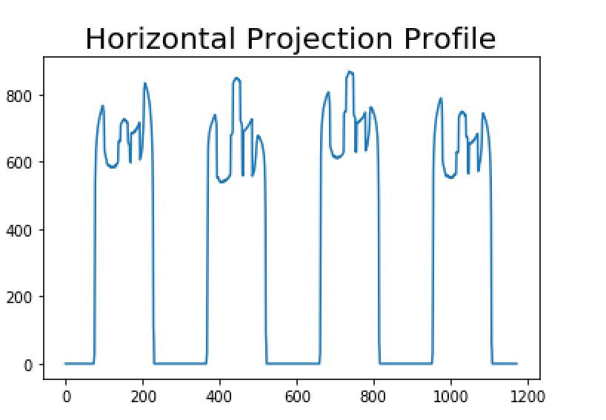
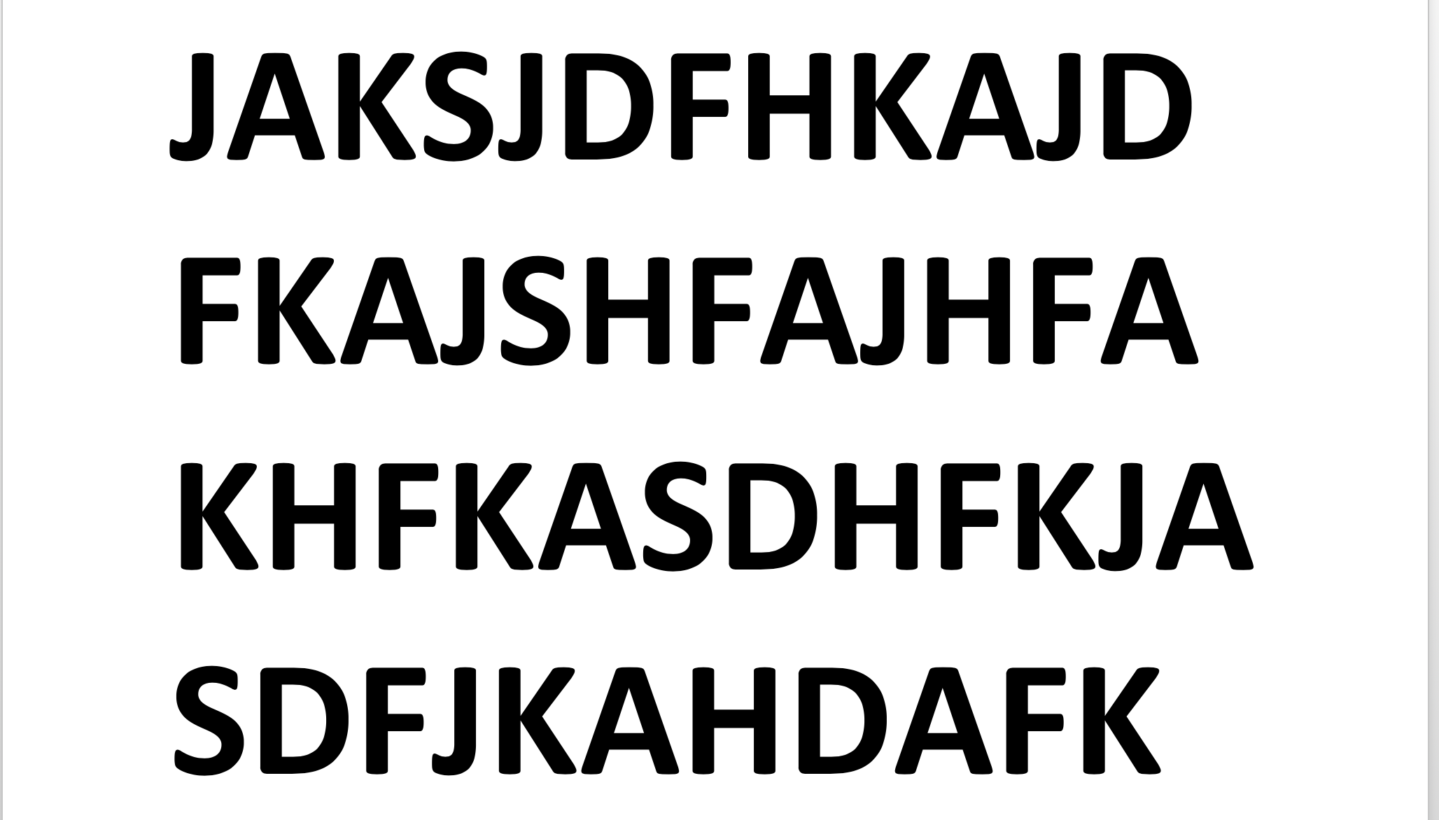
Segmentation: Horizontal Projection Profile
Notes:
To separate text lines, the horizontal projection profile of the text document image is found. The horizontal projection profile (HPP) is a Histogram of a number of ON pixels along every row of the image. When the projection profiles are plotted, we can see peaks and valleys in the plot. White space between the text lines is used to segment the text lines.
The projection profile has valleys of zero height between the text lines. Line segment is done at this point.

Slide 8
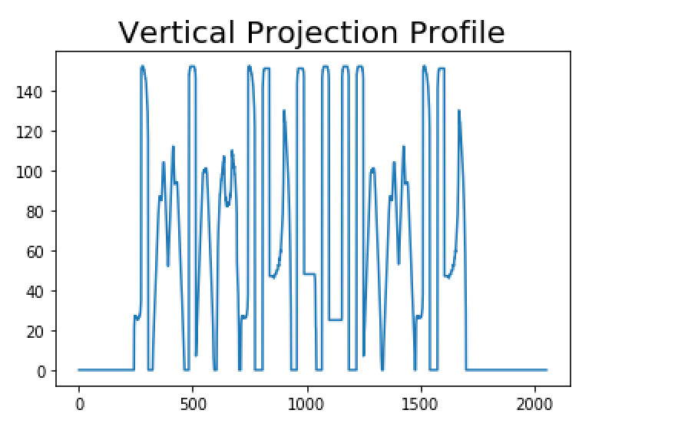
Segmentation: Vertical Projection Profile
Notes:
Vertical Projection profile is the sum of ON pixels along every column of the image. A sample input text line and its vertical projection profile is shown

Slide 9


Segmentation: Incorrect Cases
Pixels
Overlap

Slide 10
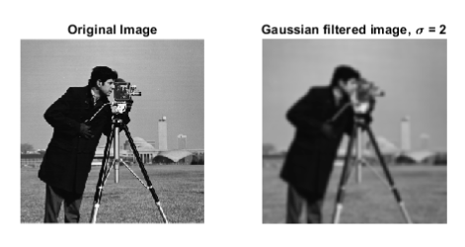
Correction Methods - Gaussian Filter
Results in a cleaner pixel array

Slide 11
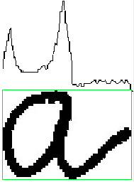
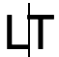
Correction Methods - Change Vertical Projection Threshold?
Proposition: Change threshold to account for smaller
peaks that represent overlap
Errors: letters that have areas
without overlap

Slide 12
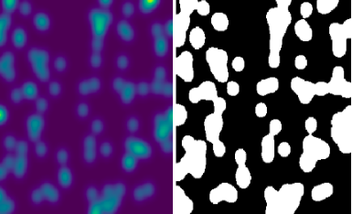
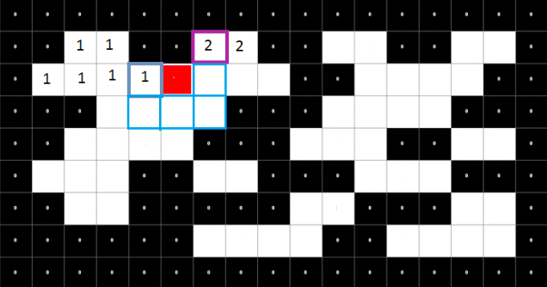
Correction Methods - Object Labeling
Algorithm for connected component labeling
Image before and after preprocessing

Slide 13
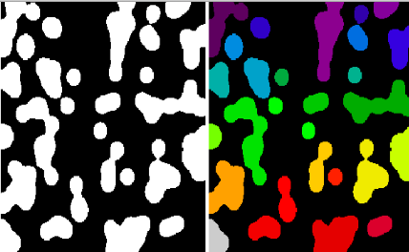
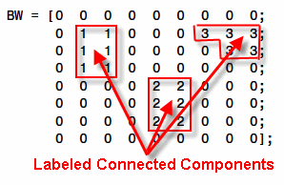
Labeled Objects

Slide 14
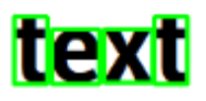

Boundary boxes and Integration

Slide 15
Convolutional Neural Network (CNN)
Notes:
Depending on the features detected by your brain, it will either classify the image as a duck or a rabbit.
The way computers classify an image is very similar to humans
A lot of uses for CNNs such as self driving cars and face recognition etc, Facebook is able to recognise people and add tags to the pictures

Slide 16
Convolutional Neural Network (CNN)
INPUT IMAGE
CNN
OUTPUT IMAGE CLASS LABEL

Slide 17
CNN
Happy
CNN
Sad

Slide 18
Convolution
Max Pooling
Flattening
Full Connection
Notes:
Now that we have seen how the images are interprestted by the computer, lets look at how the a CNN is built.

Slide 19
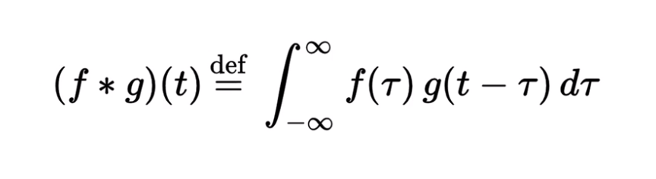
Convolution
Notes:
From signal processing classes we know this formula for convolution. But lets see what this looks like for CNNs

Slide 20
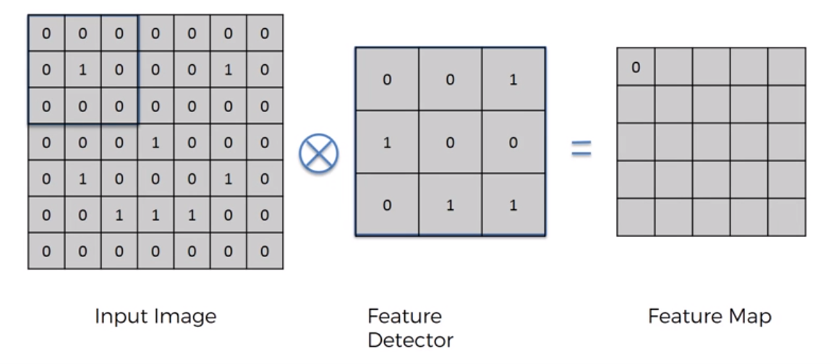
Notes:
Feature detector: In this example we use a 3x3 matrix but it is not restricted to size. Also known as Kernal or filter detector.
The convolutional sybol is represented as the x.
To get an intution of how this feature detector works, let place the filter on the input image and move it accross the image with a stride of 1.
Each cell in the feature map shows the summation of element wise multiplication of the input image and the feature detector.

Slide 21
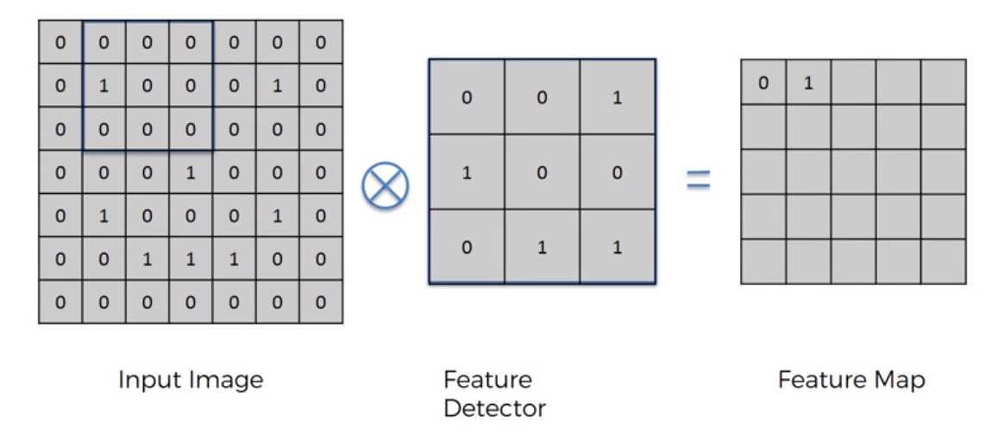

Slide 22
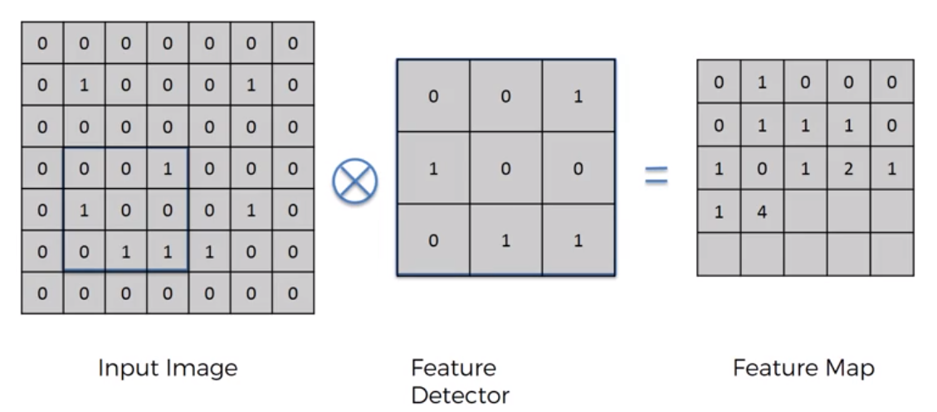

Slide 23
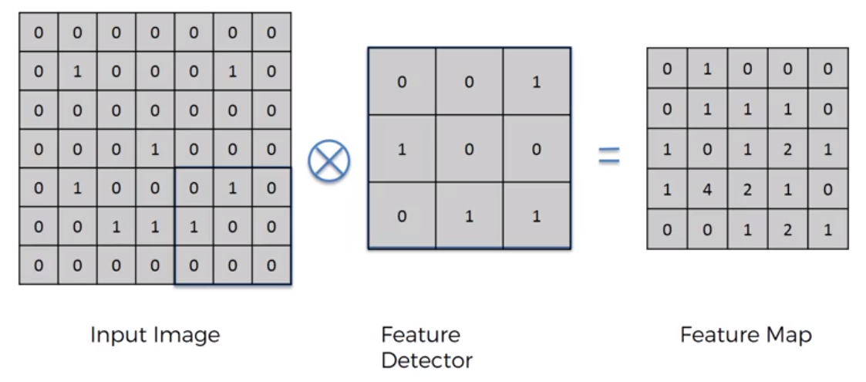
Notes:
This is what our final feature map looks like for the specific feature detector.
What we have done here is that we have reduced the size of the input image. If we would have selected a stride of 2, the image would have been even smaller.
For instance, when we try to classify an image, we do not look at the whole image, but instead try to determine features from those images. Thus the feature map preserves the feature information of an input image.

Slide 24
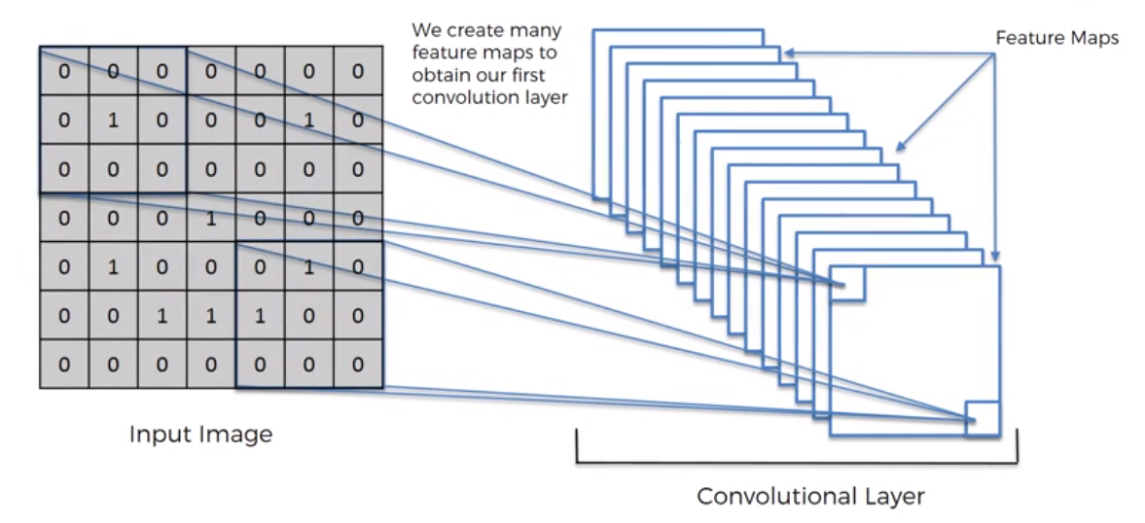
Notes:
Next we can see how multiple feature maps are created for an input image.
This happenes because we have multiple features that we want to detect on an image. Thus by performing multiple convolutions on the inuput image with different feature detectors, we obtain multiple feature maps which helps preserve information.
This is extremely important during training as the network then decides which features are important.

Slide 25
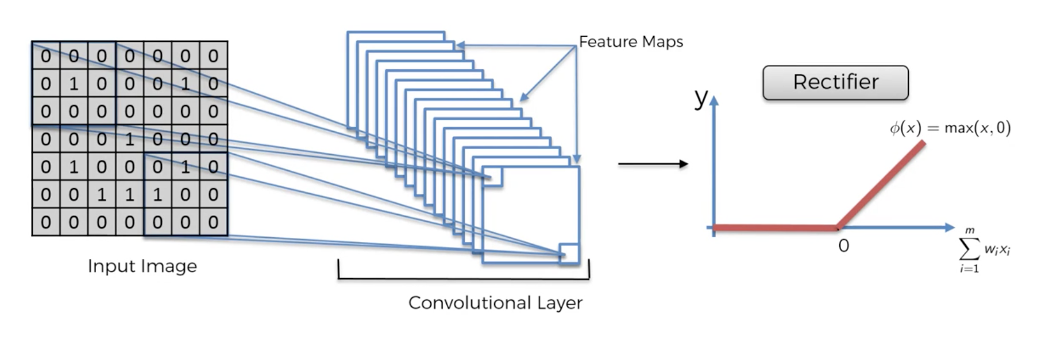
ReLU Layer
Notes:
After the convolution with multiple feature maps, there is an additional step of rectification.
The rectifier we have chosen for this project is the Relu rectifier and the shape of the graph is the one shown above
The rectifier is used to increase non-linearity in our network.
This is done because the images we will pass to the network will be non-linear since almost every image we will pass will be different.

Slide 26
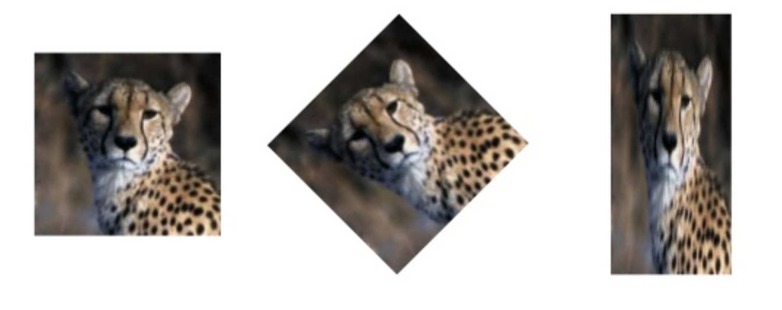
Max Pooling
Notes:
What is max pooling and why do we need it?
Consider the above images of a cheetah. No matter how we input this image into our network, we want it to recognise it as a cheetah.

Slide 27
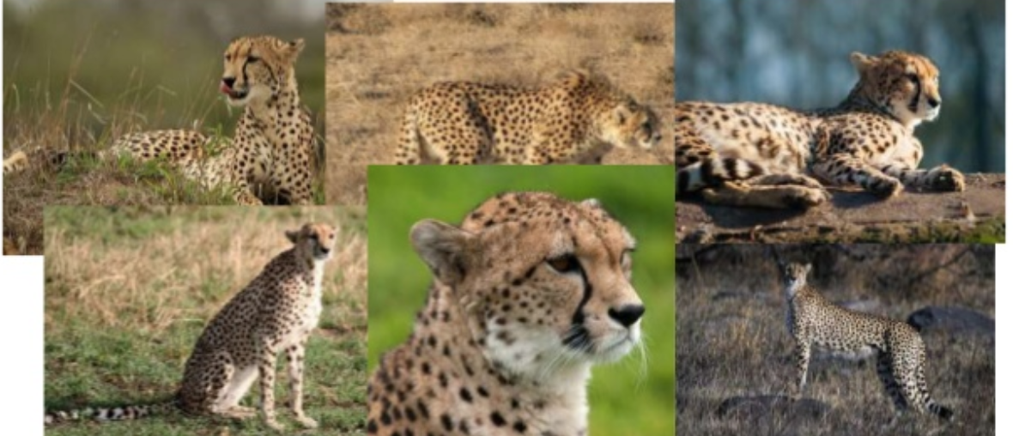
Notes:
Not only this, our network should be able to clasify all these images as a cheetah.

Slide 28
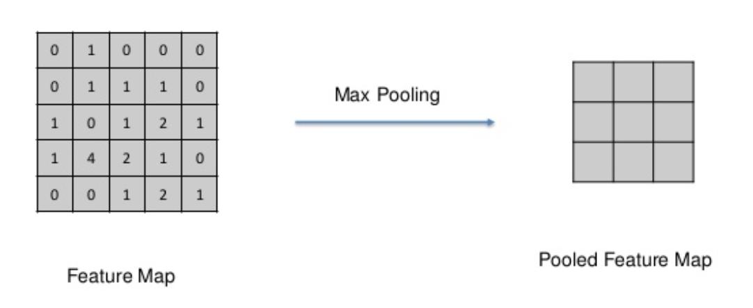
Notes:
So how does max pooling work?
Lets consider one feature map which we obtained from convolution.

Slide 29
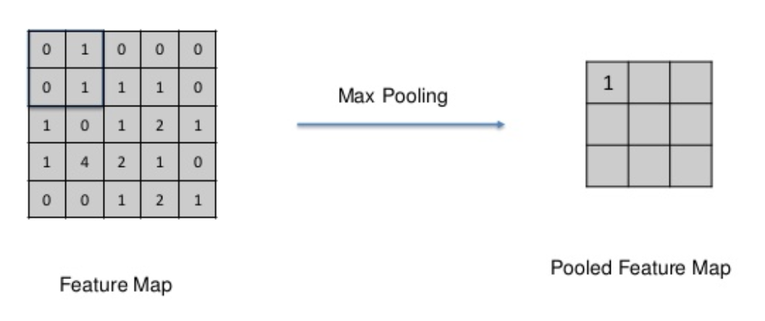
Notes:
We can choose a pixel size, in this case a 2x2, and we place it in the top left of the feature map.
Next we only consider the MAX value from this bounding pixel and record it in our pooled feature map.

Slide 30
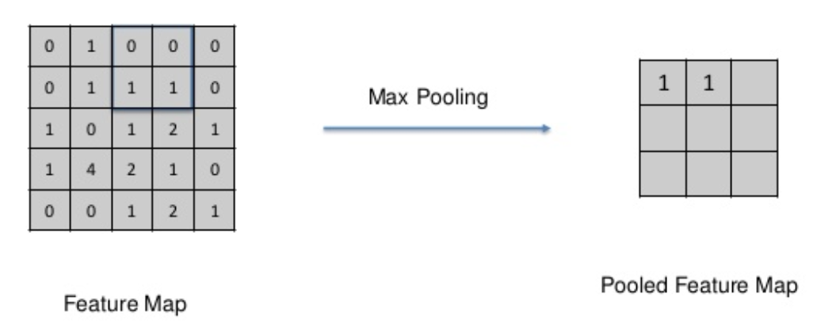

Slide 31
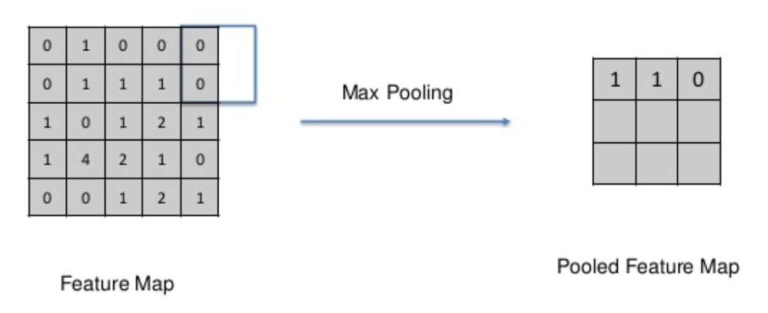

Slide 32
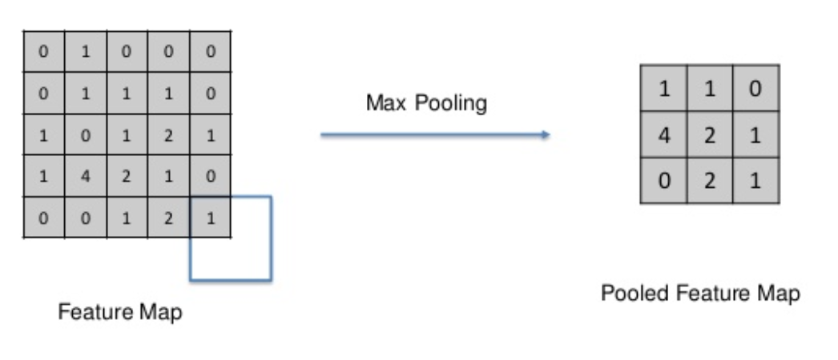
Notes:
We have now obatined our complete pooled feature map.
So now we know how max pooling works but we still dont know why we need it?
Well if you notice, if the 4 was placed in the diagonal left corner, we could still obtain the same position of 4 in the pooled feature map due to the pixel size.
This shows how the important features of the image are preserved while reducing the size of the image.
This helps the CNN take into account spacial differences or distortion in an input image.
SO max pooling allows us to preseve features,

Slide 33
Max Pooling
Preseve Features
Spatial Invariance
Reducing Size
Reducing Parameters
Notes:
Reducing size: Increases processing speed
Reducing Parameters: Increases CNN speed as we are downsampling while preseving important information and thus prevent overfitting

Slide 34
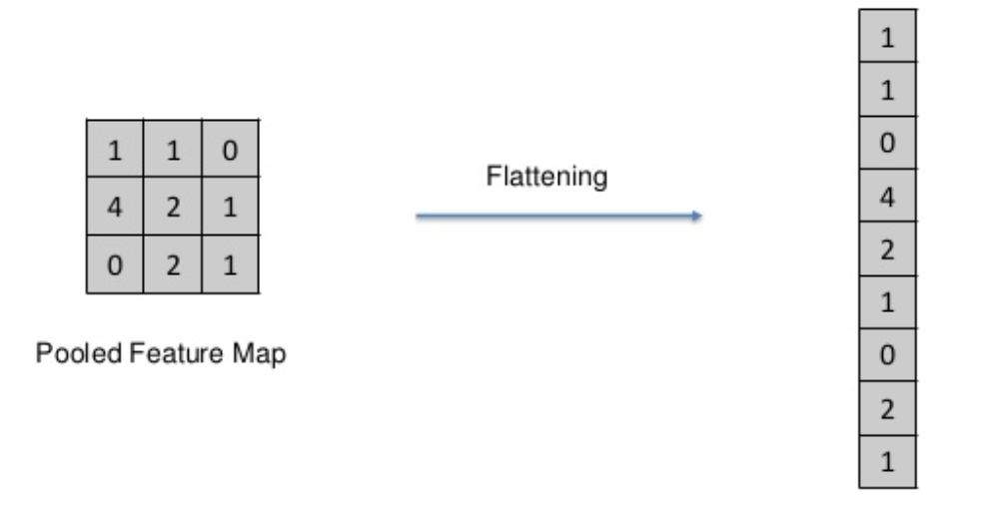
Flattening
Notes:
This step involves taking the pooled feature map which we obtain from max pooling and we flattening it into a single column which will then be fed into our CNN

Slide 35
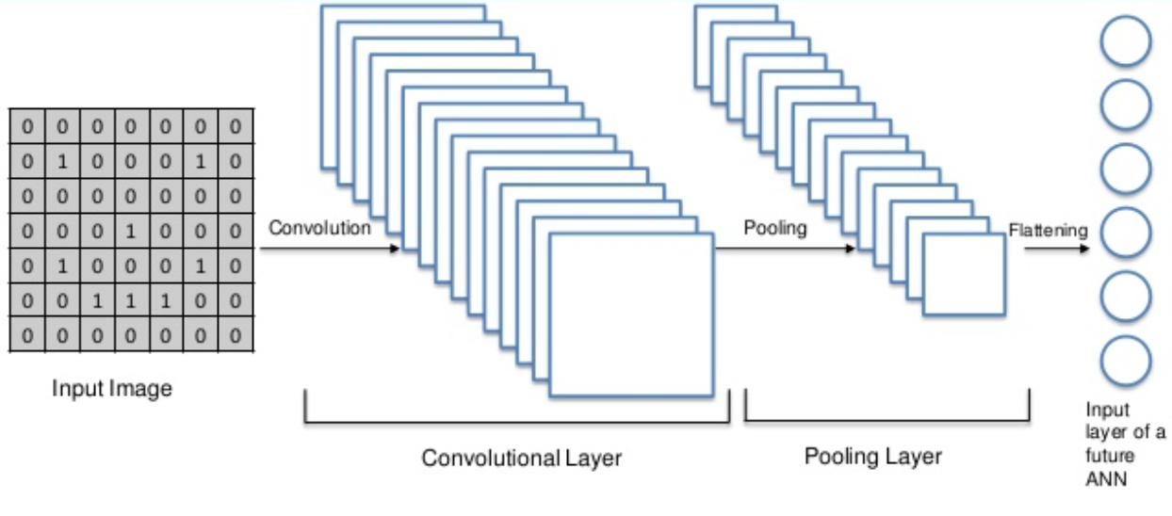

Slide 36
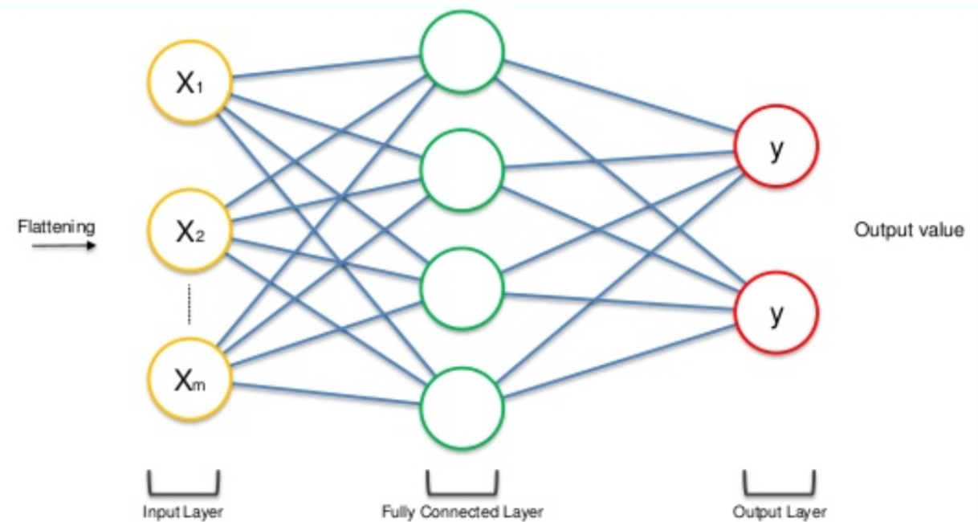
Full Connection
Notes:
Once the pooled layer has been flattened, it is fed to the input layer of an Artificial Neural Network.
The difference between an ANN used in a CNN vs a regular ANN is that the hidden layer in the CNN is fully connected.

Slide 37
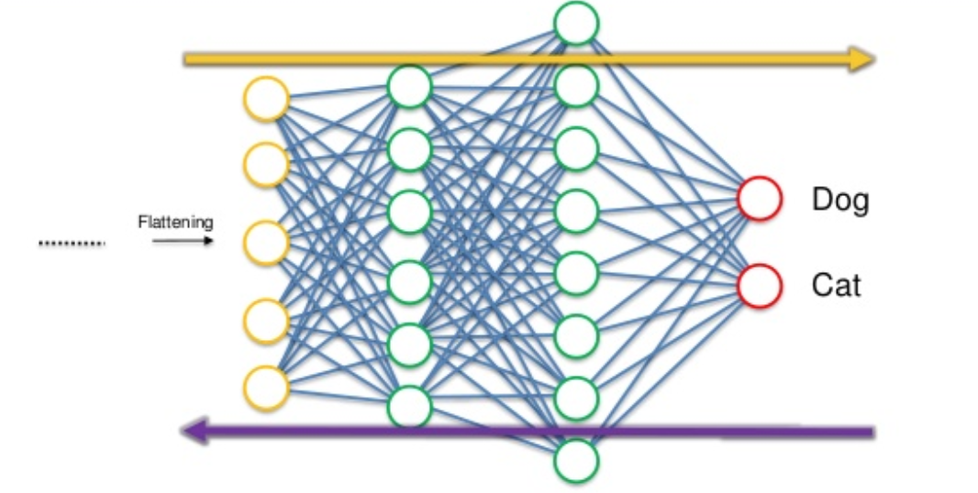
Notes:
Lets consider a more complex ANN which gives us two outputs X and Y. or Hotdog vs Pizza , or Professor Briggs Vs Jaiewei.
Once the input image is passed into the ANN the output is a prediction.
Loss function using crossentropy function
Shows how the netowrk is perferming and the weights are adjusted to optimize using back propogation and gradient descent etc.
That how the network is trained on the data
In this case we use the cross entropy function for our loss function instead of the root mean square error function which we generally use in an ANN

Slide 38
Summary
Notes:
An important difference between the training of an ANN vs a CNN is that in a CNN not only the weights are adjusted but also the feature maps are modified to only consider the important features.
In the end we get an CNN which is able to classify different images

Slide 39
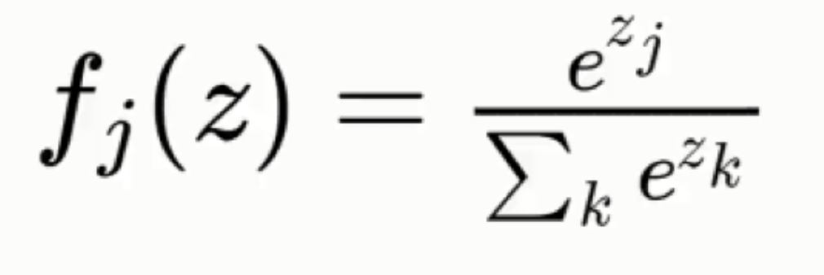
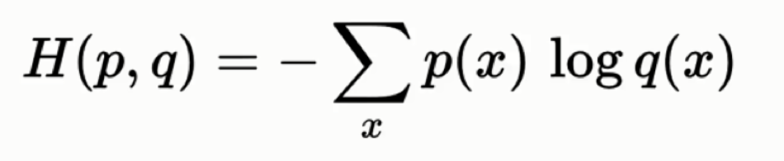
Additional Information
Softmax
Cross-Entropy
Notes:
Softmax: Ensures that the probability of the ouput classes add to 1. Without this, each output label will have an independent probability
Cross Entropy: Loss function which is

Slide 40
Challenges & Limitations
Noise Cancelling Algorithm
Runtime
Datasets for training and testing
Fine tuning parameters to avoid over and underfitting
Optimizing the CNN

Slide 41
Project Demonstration

Slide 42
Bibliography
https://scipy.github.io/devdocs/tutorial/ndimage.html
https://homepages.inf.ed.ac.uk/rbf/HIPR2/gsmooth.htm
https://www.slideshare.net/KirillEremenko/deep-learning-az-convolutional-neural-networks-cnn-module-2
https://link.springer.com/chapter/10.1007/978-3-642-29455-6_93
https://craftofcoding.files.wordpress.com/2017/02/lena.jpg
https://www.csie.ntu.edu.tw/~r93944019/cv/hw4/opening.jpg

